Slide 1
CAR PRICE PREDICTION REPORT BY PETER, GABRIEL

Slide 2
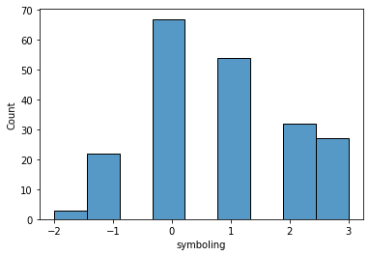
UNIVARIATE ANALYSIS Univariate analysis for symboling
This shows that, there are only few least risky cars but most cars are most risky 0,1,2 and 3

Slide 3
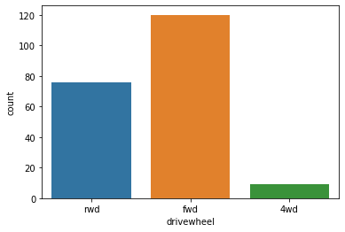
Univariate analysis for drivewheel
The chart indicates that most cars are having front wheel, follow by rarewheel then four-wheel drive

Slide 4
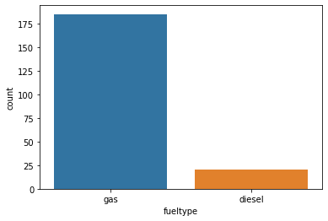
Univariate analysis of fueltype
This shows that, most cars uses gas while only few uses diesel

Slide 5
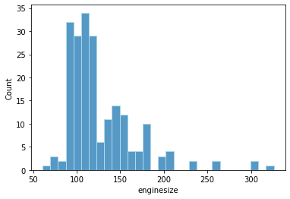
Univariate analysis enginesize
There are more cars with enginesize ranges from 90 to 120 and follow by cars with engine size 130 to 170 while only few ranges from 200 and above

Slide 6
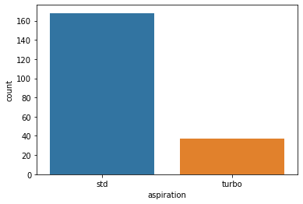
Univariate analysis aspiration
This shows that most oxygen intake is through standard atmospheric presure while only few through turbocharging (pressurised oxygen intake)

Slide 7
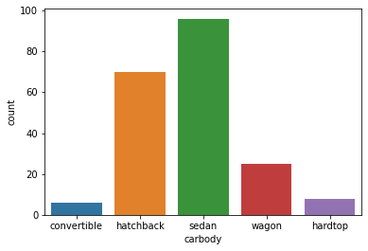
Univariate analysis carbody
This indicate that most cars has sedan body which are sold the most follow by hatchback body then wagon while only few are convertible and hardto

Slide 8
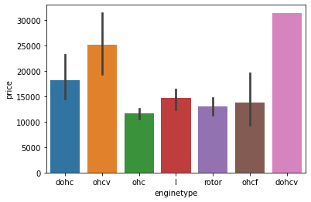
Univariate analysis enginetype
ohc Engine type seems to be most favored type. ohcv has the highest price range (While dohcv has only one row), ohc and ohcf have the low price range.

Slide 9
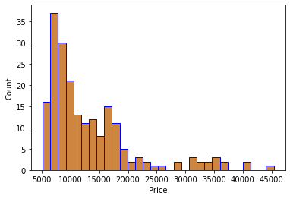
Univariate analysis price

Slide 10
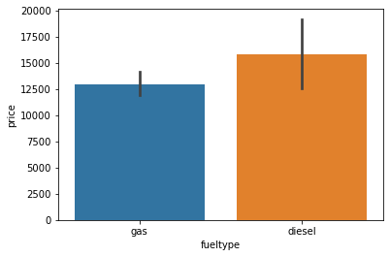
Bivariate Analysis relationship between the fueltype and carprice
The car using diesel are more costly in price compare to those cars using gas

Slide 11
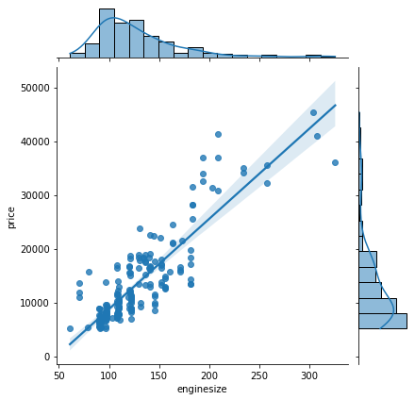
relationship between car price and enginesize
The relationship between the enginesize and the price is linear

Slide 12
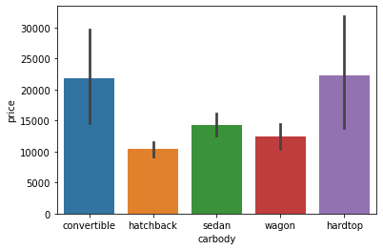
The relationship between carbody and the price
Cars with convertible bodies and those with hardtop are more costly compare to the rest

Slide 13
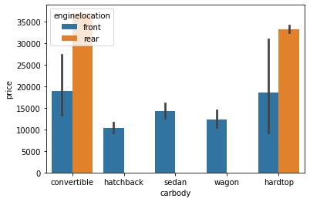
Relationship between carbody, price and enginelocation
The chart indicates that cars that are having engines located at the rear are more costly compare to the cars with engine located at the front

Slide 14
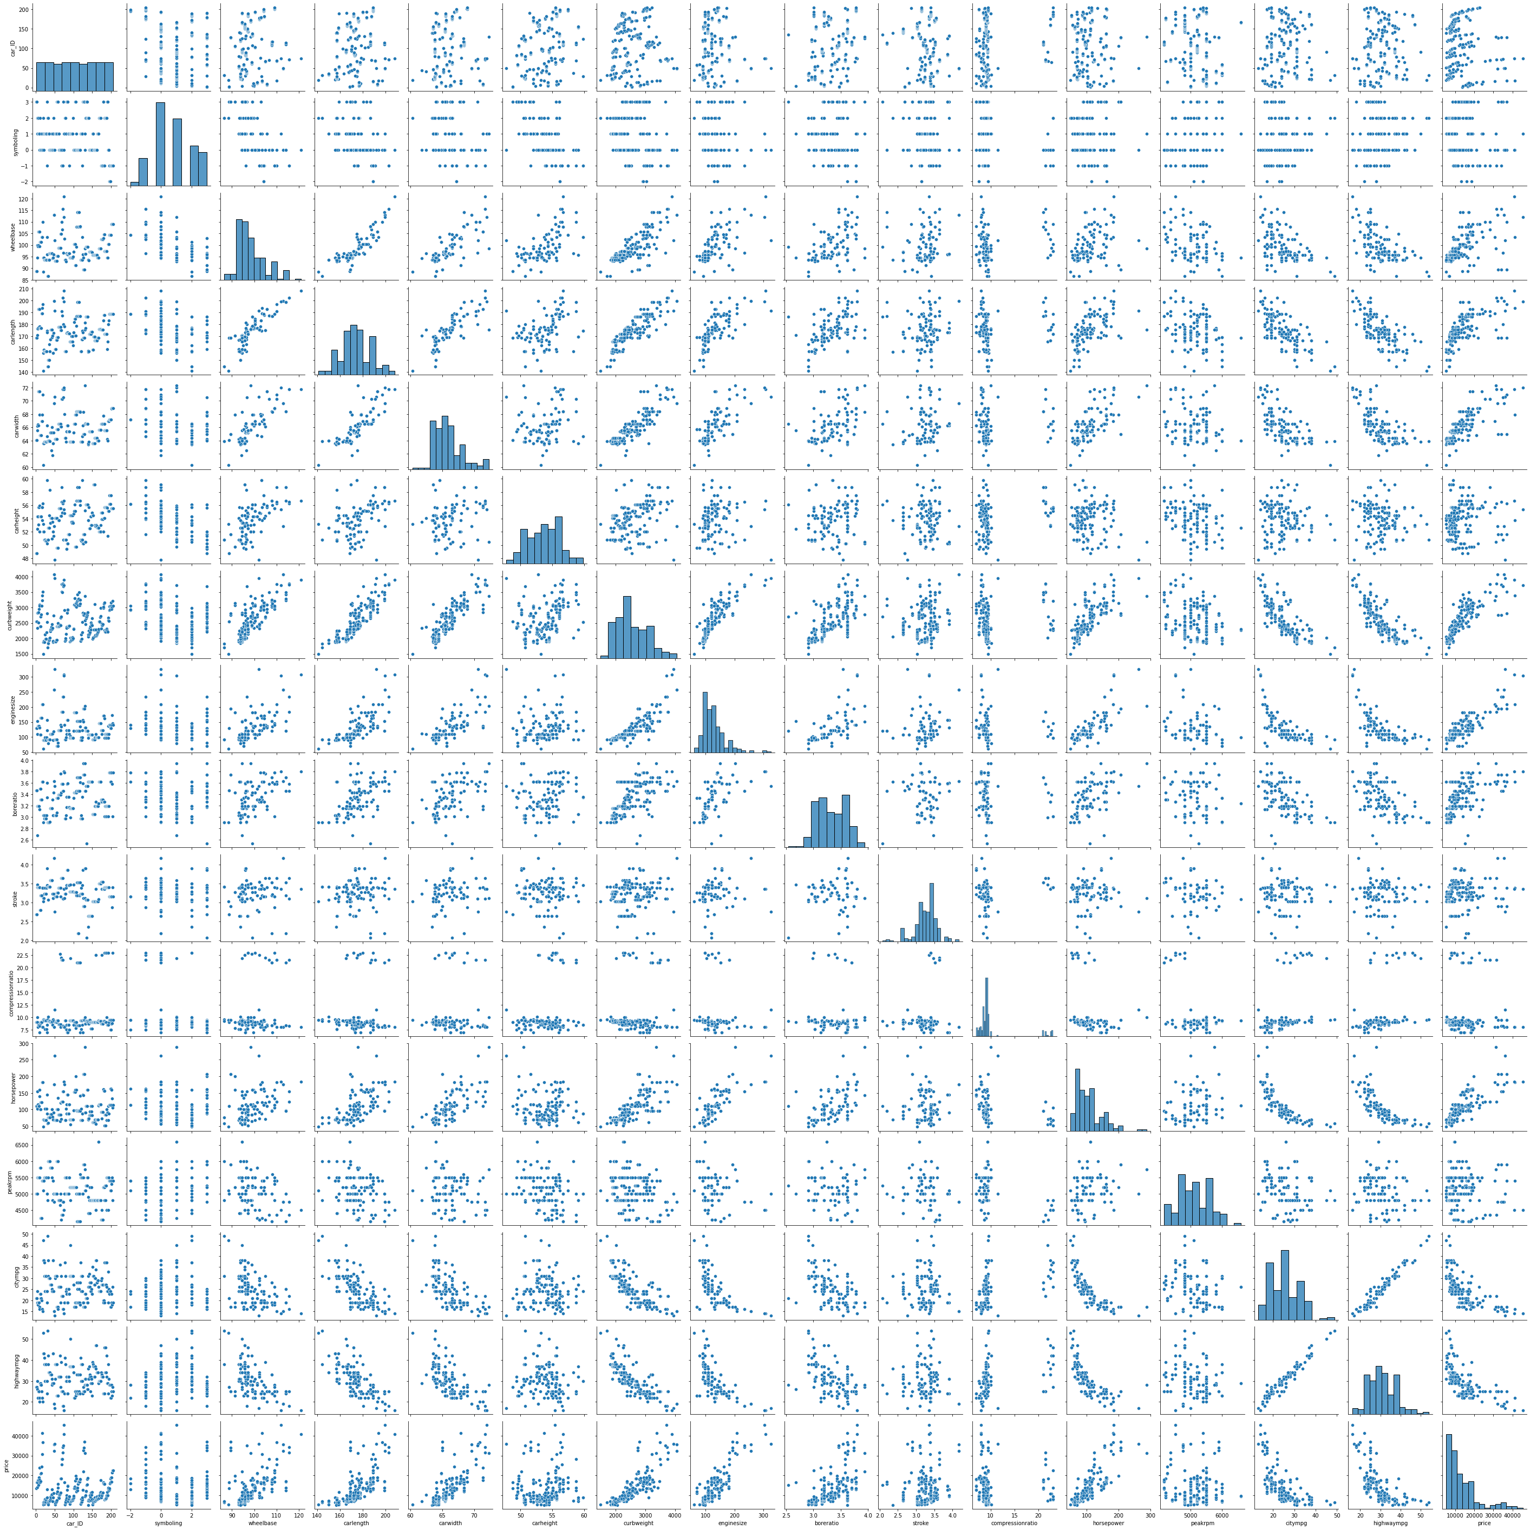
Multivariate analysis
There is form of linearity between most of the independent variables and target variable

Slide 15
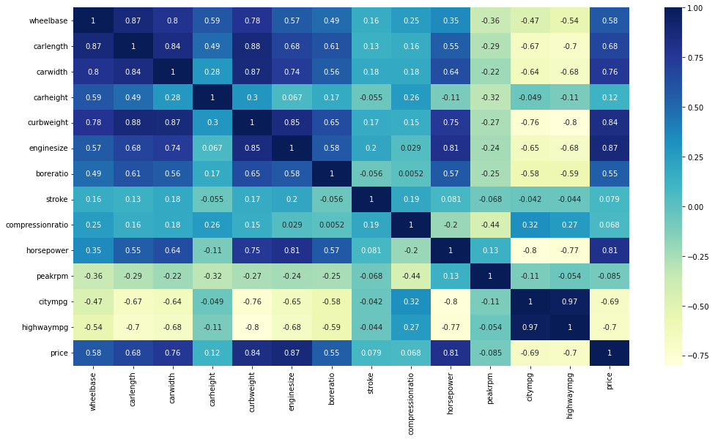
Heatmap correlation

Slide 16
Descriptions of the heatmap useful insights
Correlation of price with independent variables:
Price is highly positively correlated with wheelbase,carlength, carwidth, curbweight, enginesize, horsepower.
Price is negatively correlated to highwaympg(-0.70) and citympg (-0.69). This sugges that cars having high mileage may fall in the economy cars category, and are priced lower (think Maruti Alto/Swift type of cars, which are designed to be affordable by the middle class, who valuemileage more than horsepower/size of car etc. Correlation among independent variables: Many independent variables are highly correlated (look at the top-left part of matrix): wheelbase, carlenght,curbweight, enginesize etc. are all measures of 'size/weight', and are positively correlated Thus, while building the model, we will have to pay attention to multicollinearity (especially linear models, such as linear and logistic regression, suffer more from multicollinearity
Correlation among independent variables:
Many independent variables are highly correlated (look at the top-left part of matrix): wheelbase, carlength, curbweight, enginesize etc. are all measures of 'size/weight', and are positively correlated Thus, while building the model, we'll have to pay attention to multicollinearity (especially linear models, such as linear and logistic regression, suffer more from multicollinearity).

